Slide 1


AMONG THEM BY SULTANS OF SWING

Slide 2
TEAM PROJECT
Among them: stealth based game. you can run,
you can hide, you can shapeshift and you can die.
Game pitch (If you liked Enter the Gungeon and Ikaruga, but don't feel like shooting anyone then our game is for you)
Can be found here: UbiBelETF/dagger at team/sultans_of_swing/main (github.com)
Notes:
It’s a simple stealth game

Slide 3
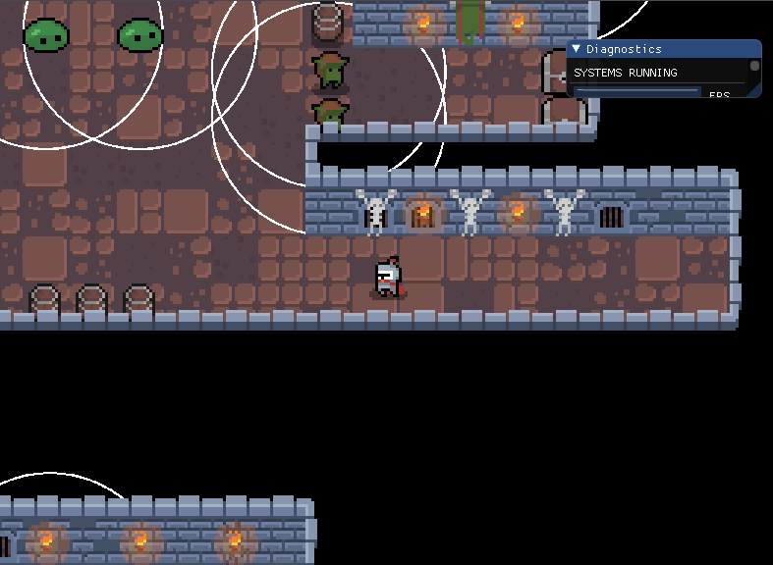
AMONG THEM SCREENSHOTS
Start of the game
Notes:
This is the picture that represents start of the game

Slide 4
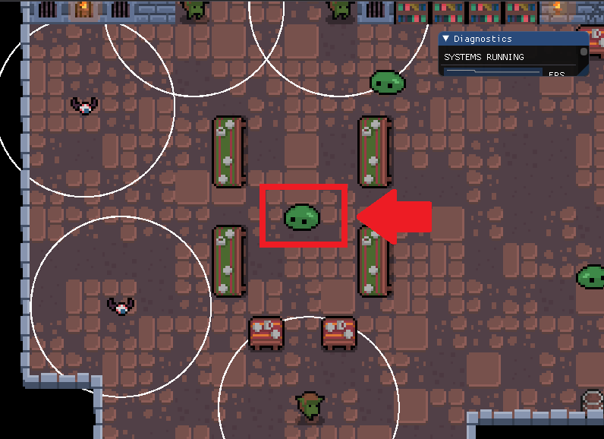
AMONG THEM SCREENSHOTS
Shapeshifting
Notes:
This shows shapeshifting where our hero is disguised as slime

Slide 5
TEAM MEMBERS
Smiljana Spasić,the presentation maker lover
Jovica Jovićević, the one with the bad internet connection
Kosta Dimitrijević,the talkative one

Slide 6
GAME DESCRIPTION
Main mechanic (the shapeshifting ability)
Setting description (trapped in dungeon)
Endgame (find the key,go to the door and escape)
Obstacles (enemies that want to catch you)
Notes:
Main mechanic (all that keeps him alive is his brains and shapeshifting, that allows him to disguise as an enemy)
Setting description (your player is trapped in dungeon that is crawling with terrifying enemies)
Endgame (your only goal is to stay alive and find the key that will open a door to your freedom)
Obstacles (beware of ruthless foes that want to spill your blood without hesitation)

Slide 7
GAME FEATURES
Controls: (you move hero with WASD keys. Shapeshifting keys are: i, o, p, l)
i(goblin) , o(slime), p(bat), l(hero)
Implemented by Jovica and Smiljana

Slide 8
GAME FEATURES
Shapeshifting
Implemented by Smiljana
Enemy AI
Implemented by Jovica,Kosta and Smiljana
Notes:
Enemies are always on alert and patrolling, if they detect you, they will chase you to your death, unless you use your shapeshifting skills or outrun them

Slide 9
GAME FEATURES
Demo level:
You are surrounded by enemies and other objects
Tilemaping and level generator
Implemented by Kosta and Jovica
Notes:
You are trapped inside a dungeon where torches on the wall are only source of light, tormented prisoners are hanging off the wall while goblins, bats and slimes are creeping through long hallways

Slide 10
GAME FEATURES
End mechanics
Find the key and get to the door
Caught by enemies=death
Implemented by Smiljana
Notes:
your only way out is locked wooden door that is guarded by goblins and the key is somewhere deep inside the dungeon

Slide 11
GAME FEATURES
Misc other features
Remote animations
Level generator
Vision cone
Movement system
Physics system
Implemented by Jovica
Notes:
Remote animations – allows our hero to have poof effect when shapeshifting
Movement and physics system – they work in tandem one is intention and other is actual movement

Slide 12

Smiljana
Ping pong feature
Dagger practice,learning about pull requests
Reviewing code
Shapeshifting system
Patrolling enemies system
End mechanic implementation, player health system
Kosta
Dagger practice
System practice
Reviewing code
Helping teammates and reviewing
Small fixes
Implementing detection
Working on chasing
Designing and implementing the level
Jovica
Dagger practice
Dagger practice
(made simple component and system)
First version of character controller, added spritesheets
Reworked character controller, camera tracking, movement system
Physics system
Finished tilemap system
Shapeshift animation, level restart, vision cones
Notes:
Getting

Slide 13
POSTMORTEM
What went well?
Team communication and cooperation was exceptional from the beginning
We managed to solve every problem quickly
We finished the game ☺

Slide 14
POSTMORTEM
What nice things were you planning to add but didn't, in the end?
Further adjustment of collision boxes
No detection trough walls
Key hidden in one of the chests
Deadly spikes that instantly kill
New enemy abilities

Slide 15
POSTMORTEM
What went wrong?
In rare cases enemies can go through walls
Uni work took a lot of our time ☹

Slide 16
POSTMORTEM
If you could start over, what would you do differently?
Organize our time better
Believe in ourselves more

Slide 17
POSTMORTEM
The things I wish Dagger had... We don’t know :D
Notes:
When we change the color of outline in our game we think that it will be nice to have predefined collors to use instead putting them manualy

Slide 18
POSTMORTEM
List some of the biggest things you've learned from this experience:
Teamwork, code review process, better understanding of ecs framework(Jovica)
Using git,working in a team,programming skills(Kosta)
More about gamedev,not to give up,coding style(Smiljana)
Notes:
Uzmi kljucne stavke od svake

Slide 19
GIFS
Notes:
Levi predstavlja – shapeshift, desni – actual gameplay, chasing, and you lose

Slide 20
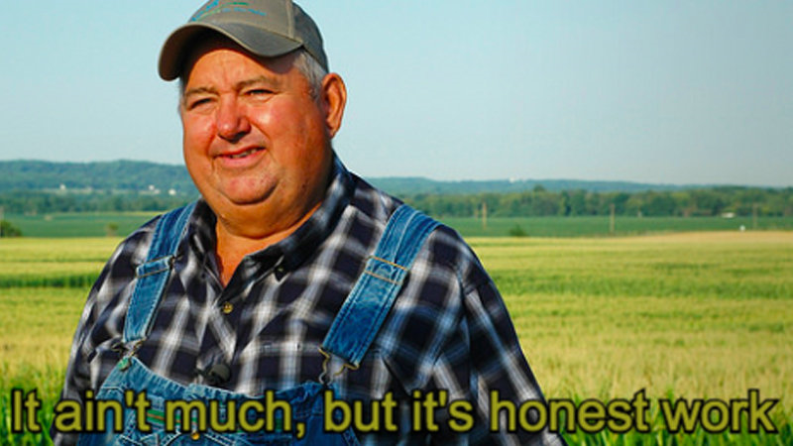
We want to share...`

Slide 21
THANK YOU!
We also wanted to thank Miroslav and Daniil for all of their hard work. For all the tips, tricks and teamwork in programming environment that they’ve thought us !
Notes:
We also wanted to thank Miroslav and Daniil for all of their hard work. For all the tips, tricks and teamwork in programming environment that they’ve thought us !

Slide 22
QUESTIONS?

